Slide 1
Locking Protocols, Deadlocks

Slide 2
Scheduling Transactions
Serial schedule: Schedule that does not interleave the actions of different transactions.
Equivalent schedules: For any database state, the effect (on the set of objects in the database) of executing the first schedule is identical to the effect of executing the second schedule.
Serializable schedule: A schedule that is equivalent to some serial execution of the transactions.
(Note: If each transaction preserves consistency, every serializable schedule preserves consistency. )
Complete schedule: a schedule that contains either an abort or a commit for each transaction whose actions are listed in it is called a complete schedule

Slide 3
Conflicting Actions
Instructions l_{i} and l_{j} of transactions T_{i} and T_{j} respectively, conflict if and only if there exists some item Q accessed by both l_{i} and l_{j}, and at least one of these instructions wrote Q.
1. l_{i} = read(Q), l_{j} = read(Q). l_{i} and l_{j} don’t conflict.
2. l_{i} = read(Q), l_{j} = write(Q). They conflict.
3. l_{i} = write(Q), l_{j} = read(Q). They conflict
4. l_{i} = write(Q), l_{j} = write(Q). They conflict
Intuitively, a conflict between l_{i} and l_{j} forces a (logical) temporal order between them.
  If l_{i} and l_{j} are consecutive in a schedule and they do not conflict, their results would remain the same even if they had been interchanged in the schedule.

Slide 4
Conflicting Actions
Two or more actions are said to be in conflict with each other if:
  The action belongs to different transactions
  At least one of the actions is write operation
  The actions access the same object (read/write)
  Conflicting actions T1:R(X), T2:W(X), T3:W(X)
  Nonconflicting actions T1:R(X), T2:R(X),T3:R(X)
  T1:R(X), T2:W(Y), T3:R(X)

Slide 5
Conflict Serializable Schedules
Two schedules are conflict equivalent if:
  Involve the same actions of the same transactions
  Every pair of conflicting actions is ordered the same way
Schedule S is conflict serializable if S is conflict equivalent to some serial schedule

Slide 6


Conflict Serializability
Schedule 3 can be transformed into Schedule 6, a serial schedule where T₂ follows T₁, by series of swaps of non-conflicting instructions. Therefore Schedule 3 is conflict serializable.
Schedule 3
Schedule 6

Slide 7

Conflict Serializability
Example of a schedule that is not conflict serializable:
We are unable to swap instructions in the above schedule to obtain either the serial schedule < T₃, T₄ >, or the serial schedule < T₄, T₃ >.

Slide 8
Example
A schedule that is not conflict serializable:
The cycle in the graph G (V,E) reveals the problem. The output of T1 depends on T2, and vice-versa
T1: R(A), W(A), R(B), W(B)
T2: R(A), W(A), R(B), W(B)
A
T1
T2
B

Slide 9
Precedence Graph
One node per Xact; edge from Ti to Tj if actions of Ti precedes and conflicts with one of Tj’s actions
Theorem: Schedule is conflict serializable if and only if its precedence graph is acyclic

Slide 10
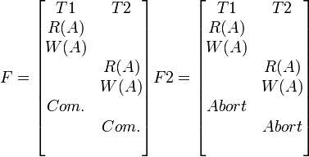
Recoverable Schedule
Transactions commit only after all transactions whose changes they read, commit.
Schedule F is recoverable because T1 commits before T2, that makes the value read by T2 correct. Then T2 can commit itself. In F2, if T1 aborted, T2 has to abort because the value of A it read is incorrect. In both cases, the database is left in a consistent state.

Slide 11
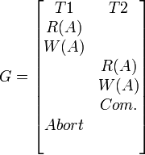
Unrecoverable Schedule
If a transaction T1 aborts, and a transaction T2 commits, but T2 relied on T1, we have an unrecoverable schedule.
In this example, G is unrecoverable, because T2 read the value of A written by T1, and committed. T1 later aborted, therefore the value read by T2 is wrong, but since T2 committed, this schedule is unrecoverable.

Slide 12

Cascading Rollback
a single transaction failure leads to a series of transaction rollbacks. Consider the following schedule where none of the transactions has yet committed (so the schedule is recoverable)
If T₁₀ fails, T₁₁ and T₁₂ must also be rolled back.
Can lead to the undoing of a significant amount of work

Slide 13
Cascadeless Schedules
cascading rollbacks cannot occur; for each pair of transactions T_{i} and T_{j} such that T_{j} reads a data item previously written by T_{i}, the commit operation of T_{i} appears before the read operation of T_{j}.
Every cascadeless schedule is also recoverable
It is desirable to restrict the schedules to those that are cascadeless

Slide 14
Concurrency Control (CC)
A database must provide a mechanism that will ensure that all possible schedules are
  conflict serializable
    and
  are recoverable and preferably cascadeless
A policy in which only one transaction can execute at a time generates serial schedules, but provides a poor degree of concurrency
Testing a schedule for serializability after it has executed is a little too late!
to develop concurrency control protocols that will assure serializability.

Slide 15
CC
A policy in which only one transaction can execute at a time generates serial schedules, but provides a poor degree of concurrency.
Concurrency-control schemes tradeoff between the amount of concurrency they allow and the amount of overhead that they incur.

Slide 16
Concurrency Control Protocols
Lock-Based Protocols
Timestamp-Based Protocols
Validation-Based Protocols

Slide 17
Lock Based CC
Only serializable, recoverable schedules are allowed, no actions of committed transactions are lost while undoing aborted transactions
Use of locks
Locking protocol is a set of rules to be followed by each transaction to ensure that net effect of interleaved transactions is identical to some serial execution

Slide 18
Lock-Based Protocols
A lock is a mechanism to control concurrent access to a data item
Data items can be locked in two modes:
1. exclusive (X) mode. Data item can be both read as well as
written. X-lock is requested using lock-X instruction.
2. shared (S) mode. Data item can only be read. S-lock is
requested using lock-S instruction.
Lock requests are made to concurrency-control manager. Transaction can proceed only after request is granted.

Slide 19
Lock Management
Lock and unlock requests are handled by the lock manager
Maintains Lock table entry:
  Number of transactions currently holding a lock
  Type of lock held (shared or exclusive)
  Pointer to queue of lock requests
Locking and unlocking have to be atomic operations
Lock upgrade: transaction that holds a shared lock can be upgraded to hold an exclusive lock
Descriptive entry in transaction table for each transaction
Entry contains pointer to a list of locks held by the transaction
This list is checked before requesting a lock to ensure that a transaction does not request the same lock twice

Slide 20
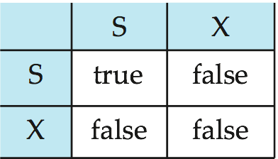
Lock-Based Protocols
Lock-compatibility matrix
A transaction may be granted a lock on an item if the requested lock is compatible with locks already held on the item by other transactions.
Any number of transactions can hold shared locks on an item,
  but if any transaction holds an exclusive lock on the item no other transaction may hold any lock on the item.
If a lock cannot be granted, the requesting transaction is made to wait till all incompatible locks held by other transactions have been released. The lock is then granted.

Slide 21
Lock-Based Protocols
Example of a transaction performing locking:
T₂: lock-S(A);
read (A);
unlock(A);
lock-S(B);
read (B);
unlock(B);
display(A+B)
Locking as above is not sufficient to guarantee serializability — if A and B get updated in-between the read of A and B, the displayed sum would be wrong.
A locking protocol is a set of rules followed by all transactions while requesting and releasing locks. Locking protocols restrict the set of possible schedules.

Slide 22
Strict 2PL
  Most widely used Locking Protocol
  Growing: Each transaction must obtain a S (shared) lock on object before reading, and an X (exclusive) lock on object before writing.
  Shrinking: All locks held by a transaction are released when the transaction completes

Slide 23
Strict 2 PL
  If an transaction holds an X lock on an object, no other transaction can get a lock (S or X) on that object.
  A transaction that requests a lock is suspended until DBMS is able to grant the requested lock
  DBMS keeps track of locks it has granted
Strict 2PL allows only schedules whose precedence graph is acyclic

Slide 24
Implementation of Locking
A lock manager can be implemented as a separate process to which transactions send lock and unlock requests
The lock manager replies to a lock request by sending a lock grant messages (or a message asking the transaction to roll back, in case of a deadlock)
The requesting transaction waits until its request is answered
The lock manager maintains a data-structure called a lock table to record granted locks and pending requests
The lock table is usually implemented as an in-memory hash table indexed on the name of the data item being locked

Slide 25
Lock Table
Lock manager uses this data structure
For each data item, that is currently locked, it maintains a linked list of records, one for each request, in the order in which the requests arrived
It uses a hash table, indexed on the name of the data item, to find the linked list (if any) for the data item (lock table)
Each record of the linked list for a data item notes which transaction made the request, and what lock mode it requested
The record also notes if the request currently been granted

Slide 26
Lock Table
Five data items: 14,17, 123, 144, 1912
The locked table uses overflow chaining, so there is a linked list of data items for each entry in the lock table
There is also a list of transactions that have been granted locks

Slide 27
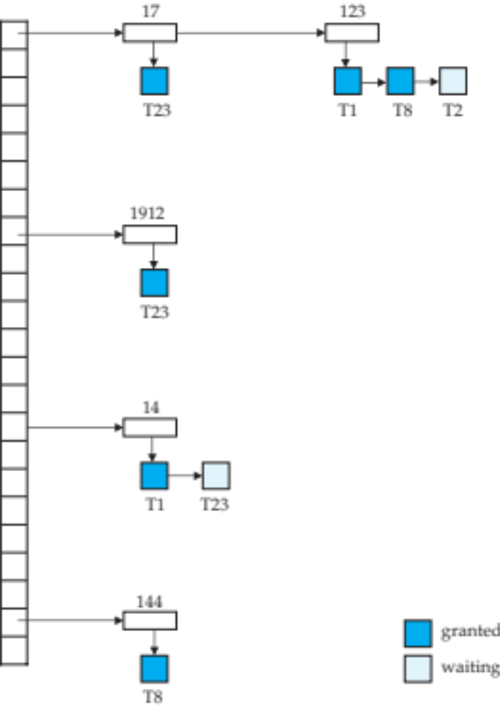
Lock Table
Blue rectangles indicate granted locks, white ones indicate waiting requests
Lock table also records the type of lock granted or requested
New request is added to the end of the queue of requests for the data item, and granted if it is compatible with all earlier locks
Unlock requests result in the request being deleted, and later requests are checked to see if they can now be granted
If transaction aborts, all waiting or granted requests of the transaction are deleted
  lock manager may keep a list of locks held by each transaction, to implement this efficiently

Slide 28
Anomalies with Interleaved Execution
WR Conflict
Reading Uncommitted Data (WR Conflicts, “dirty reads”):
T2 reads A that has been modified by another transaction T1, which has not yet committed (dirty read)
T1: Doubles number, T2: Subtracts 50
t=0 A=B=100
  The DBMS’s view of a schedule:
T1: R(A), W(A), R(B), W(B)
T2: R(A), W(A), R(B), W(B)

Slide 29
WR Conflict
T1,T2 : A= 150 , B= 150
T2,T1 : A= 100 , B= 100
Interleaved execution not equivalent to either of the serial executions
Using Strict 2PL, interleaving is not allowed for T1, T2

Slide 30
Unrepeatable Reads RW Conflicts
Unrepeatable Reads (RW Conflicts):
T2 could change the value of object A that has been read by transaction T1, while T1 is still in progress
If T1 tries to read A again, it will get a different result, even though it has not modified A in the meantime
Suppose both T1 and T2 read the same value of A, say 5, and then T1 which wants to increment A by 1 changes it to 6, and T2 (decrements by 1) changes it to 4.
Although T2’s change is not directly read by T1, it invalidates T1’s assumption about the value of A
T1: R(A), W(A),
T2: R(A), W(A),

Slide 31
Overwriting Uncommitted Data WW Conflicts
Blind write
  T1 sets salary to 50K
  T2 sets salary to 80K
  Both employees should get same salary
  Lost update Problem
T1: W(A), W(B), C
T2: W(A), W(B), C

Slide 32
Two-Phase Locking (2PL) Protocol
  Each Xact must obtain a S (shared) lock on object before reading, and an X (exclusive) lock on object before writing.
  A transaction can not request additional locks once it releases any locks.
  If a Xact holds an X lock on an object, no other Xact can get a lock (S or X) on that object.

Slide 33
The Two-Phase Locking Protocol
This is a protocol which ensures conflict-serializable schedules.
Phase 1: Growing Phase
  transaction may obtain locks
  transaction may not release locks
Phase 2: Shrinking Phase
  transaction may release locks
  transaction may not obtain locks
The protocol assures serializability. It can be proved that the transactions can be serialized in the order of their lock points (i.e., the point where a transaction acquired its final lock).

Slide 34
The Two-Phase Locking Protocol
Two-phase locking does not ensure freedom from deadlocks.
Cascading roll-back is possible under two-phase locking. To avoid this, follow a modified protocol called strict two-phase locking. Here a transaction must hold all its exclusive locks till it commits/aborts.
Rigorous two-phase locking is even stricter: here all locks are held till commit/abort. In this protocol transactions can be serialized in the order in which they commit. (Strict 2PL)

Slide 35
Deadlocks
Transaction T1 sets X-lock on A, T2 set X-lock on B, T1 requests X-lock on B, T1 request X-lock on A
T1 waiting for T2 to release X-lock on B and T2 waiting for T1 to release X-lock on A
Cycle of transactions waiting for a lock

Slide 36

Pitfalls of Lock-Based Protocols
Consider the partial schedule
Neither T₃ nor T₄ can make progress — executing lock-S(B) causes T₄ to wait for T₃ to release its lock on B, while executing lock-X(A) causes T₃ to wait for T₄ to release its lock on A.
Such a situation is called a deadlock.
  To handle a deadlock one of T₃ or T₄ must be rolled back
  and its locks released.

Slide 37
Pitfalls of Lock-Based Protocols
The potential for deadlock exists in most locking protocols. Deadlocks are a necessary evil.
Starvation is also possible if concurrency control manager is badly designed. For example:
  A transaction may be waiting for an X-lock on an item, while a sequence of other transactions request and are granted an S-lock on the same item.
  The same transaction is repeatedly rolled back due to deadlocks.
Concurrency control manager can be designed to prevent starvation.

Slide 38
Deadlocks
Deadlock: Cycle of transactions waiting for locks to be released by each other.
Two ways of dealing with deadlocks:
  Deadlock prevention
  Deadlock detection
Identification of deadlocks using timeout mechanism: transaction waiting for too long…assuming it is a deadlock …abort it
Blocking : blocked transactions may hold other locks that force other transactions to wait
Aborting and restarting: wastes the work done

Slide 39
Deadlock prevention
protocols ensure that the system will never enter into a deadlock state. Some prevention strategies:
  Require that each transaction locks all its data items before it begins execution (predeclaration).
  Impose partial ordering of all data items and require that a transaction can lock data items only in the order specified by the partial order (graph-based protocol).

Slide 40
More Deadlock Prevention Strategies
Following schemes use transaction timestamps for the sake of deadlock prevention alone.
wait-die scheme —
  older transaction may wait for younger one to release data item. Younger transactions never wait for older ones; they are rolled back instead.
  a transaction may die several times before acquiring needed data item
wound-wait scheme —
  older transaction wounds (forces rollback) of younger transaction instead of waiting for it. Younger transactions may wait for older ones.
  may be fewer rollbacks than wait-die scheme

Slide 41
Deadlock Prevention
Assign priorities based on timestamps. Assume Ti wants a lock that Tj holds. Two policies are possible:
  Wait-Die: It Ti has higher priority, Ti waits for Tj; otherwise Ti aborts
  Wound-wait: If Ti has higher priority, Tj aborts; otherwise Ti waits
  Fewer rollbacks in wound-wait
If a transaction re-starts, make sure it has its original timestamp

Slide 42
Wait-Die
  Lower the timestamp, higher the priority
  If Ti has higher priority, Ti waits for Tj; otherwise Ti aborts
  Lower priority transactions can never wait for higher priority transactions
  To ensure that no transaction is repeatedly aborted, when a transaction is aborted and hence restarted, it will be given the original timestamp it had
  Only a transaction requesting a lock can be aborted
  As the transaction grows older, it tends to wait for more and more younger transactions. The conflicting younger transaction may be repeatedly aborted. But a transaction having all the locks will never be aborted.

Slide 43
Wound-Wait
If Ti has higher priority, Tj aborts; otherwise Ti waits
A transaction that has all the locks it needs may get aborted

Slide 44
Deadlock prevention
Both in wait-die and in wound-wait schemes, a rolled back transactions is restarted with its original timestamp. Older transactions thus have precedence over newer ones, thus starvation is avoided
Timeout-Based Schemes:
  a transaction waits for a lock only for a specified amount of time. After that, the wait times out and the transaction is rolled back.
  thus deadlocks are not possible
  simple to implement; but starvation is possible. Also difficult to determine good value of the timeout interval.

Slide 45
Deadlock Detection
Create a wait-for graph:
  Nodes are transactions
  There is an edge from Ti to Tj if Ti is waiting for Tj to release a lock
Periodically check for cycles in the waits-for graph

Slide 46
Schedule
T1: S(A), R(A), S(B)
T2: X(B),W(B) X(C)
T3: S(C), R(C) X(A)
T4: X(B)
S1(A), R1(A), X2(B), S1(B),W2(B), S3(C),R3(C), X2(C), X4(B), X3(A)

Slide 47
Deadlock Detection (Continued)
Example:
T1: S(A), R(A), S(B)
T2: X(B),W(B) X(C)
T3: S(C), R(C) X(A)
T4: X(B)
T1
T2
T1
T2
T4
T3
T3
T3

Slide 48
Deadlock Detection
Deadlocks can be described as a wait-for graph, which consists of a pair G = (V,E),
  V is a set of vertices (all the transactions in the system)
  E is a set of edges; each element is an ordered pair T_{i} →T_{j}.
If T_{i} → T_{j} is in E, then there is a directed edge from T_{i} to T_{j}, implying that T_{i} is waiting for T_{j} to release a data item.
When T_{i} requests a data item currently being held by T_{j}, then the edge T_{i} T_{j} is inserted in the wait-for graph. This edge is removed only when T_{j} is no longer holding a data item needed by T_{i}.
The system is in a deadlock state if and only if the wait-for graph has a cycle. Must invoke a deadlock-detection algorithm periodically to look for cycles.

Slide 49
Deadlock Recovery
When deadlock is detected:
Selection of victim, rollback, starvation
  Selection of victim: Some transaction will have to be rolled back (made a victim) to break deadlock. Select that transaction as victim that will incur minimum cost.
    How long it has computed and how long is still to go?
    Number of data items already used by it
    Number of data items to be used further by it
    Number of transactions involved in rollback

Slide 50
Deadlock Recovery
  Rollback -- determine how far to roll back transaction
    Total rollback: Abort the transaction and then restart it.
    Partial rollback: More effective to roll back transaction only as far as necessary to break deadlock.
      Needs to keep additional information like state of all running ,
      Sequence of lock request/grants and updates performed by
      Transition
      Detection mechanism should decide which locks the selected
      Transactions needs to release to break the deadlock
      The selected transaction must be rolled back to the point where it
      obtained first of these locks, undoing all actions it took after that
      point
  Starvation happens if same transaction is always chosen as victim.
  Include the number of rollbacks in the cost factor to avoid
  starvation

Slide 51
Multiple Granularity
Allow data items to be of various sizes and define a hierarchy of data granularities, where the small granularities are nested within larger ones.
Can be represented graphically as a tree (but don't confuse with tree-locking protocol)
When a transaction locks a node in the tree explicitly, it implicitly locks all the node's descendents in the same mode.
Granularity of locking (level in tree where locking is done):
  fine granularity (lower in tree): high concurrency, high locking overhead
  coarse granularity (higher in tree): low locking overhead, low concurrency

Slide 52
Granularity
Data items are of various sizes
Defining hierarchy of data granularities where small granularities are nested within larger ones
Tree
A nonleaf node of multi granularity tree represents data associated with its descendants

Slide 53
Multiple-Granularity Locks
Hard to decide what granularity to lock (tuples vs. pages vs. tables).
Shouldn’t have to decide!
Data “containers” are nested:
Database
contains
Files
Pages
Tuples

Slide 54
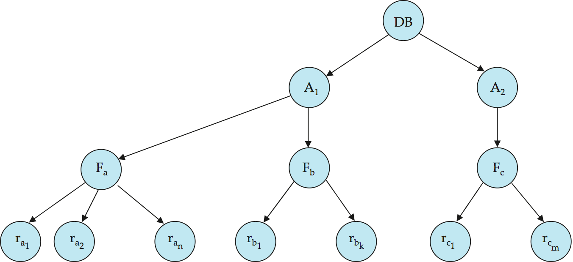
Example of Granularity Hierarchy
The levels, starting from the coarsest (top) level are:
  database
  file
  record

Slide 55
Multigranularity Locking
When transaction locks node in shared or exclusive mode, the transaction has also implicitly locked all the descendents of that node in the same lock mode
If transaction gets explicit X-lock on file F_{c} then it has an implicit lock in X-mode on all the records belonging to that file
Suppose T_{j} wants to lock record r_{b6} of file F_{b}
If T_{j} already has locked F_{b} explicitly, then r_{b6} is locked implicitly
How does a system determine whether T_{j} can lock r_{b6} (when lock request for r_{b6} is coming from T_{j} ?
  T_{j} must traverse the tree from the root to the record r_{b6}
  If any node in that path is locked in an incompatible mode then T_{j} must be delayed
How to determine that root node can be locked? (search entire tree!)
(use new type of lock, intention lock mode)

Slide 56
Intention Lock Modes
If a node is locked in intention mode, explicit locking is done at a lower level
Intention locks are put on all ancestors of a node before that node is locked explicitly
A transaction does not need to search the entire tree to determine whether it can lock a node successfully
Transaction wishing to lock a node (Q) must traverse a path from root to Q and lock various nodes in intention mode
In addition to X and S locks
  intention-shared (IS): indicates explicit locking at a lower level of the tree but only with shared locks.
  intention-exclusive (IX): indicates explicit locking at a lower level with exclusive or shared locks
  shared and intention-exclusive (SIX): the subtree rooted by that node is locked explicitly in shared mode and explicit locking is being done at a lower level with exclusive-mode locks.
Intention locks allow a higher level node to be locked in S or X mode without having to check all descendent nodes.

Slide 57
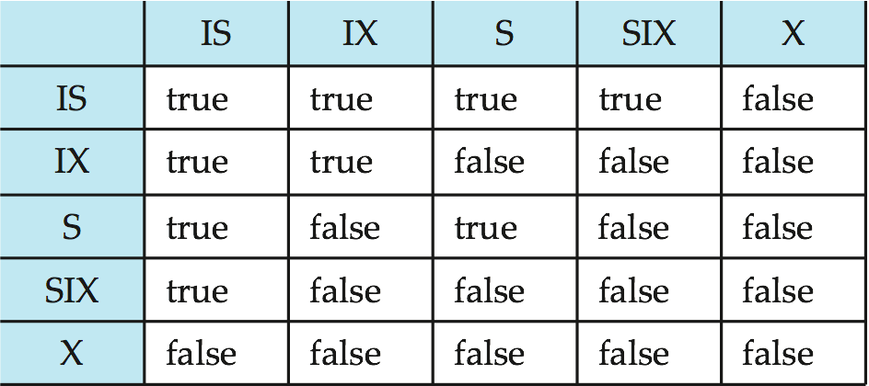
Compatibility Matrix with Intention Lock Modes
The compatibility matrix for all lock modes is:

Slide 58
Multiple Granularity Locking Scheme
Transaction T_{i} can lock a node Q, using the following rules:
  The lock compatibility matrix must be observed.
  The root of the tree must be locked first, and may be locked in any mode.
  A node Q can be locked by T_{i} in S or IS mode only if the parent of Q is currently locked by T_{i} in either IX or IS mode.
  A node Q can be locked by T_{i} in X, SIX, or IX mode only if the parent of Q is currently locked by T_{i} in either IX or SIX mode.
  T_{i} can lock a node only if it has not previously unlocked any node (that is, T_{i} is two-phase).
  T_{i} can unlock a node Q only if none of the children of Q are currently locked by T_{i}.
Observe that locks are acquired in root-to-leaf order, whereas they are released in leaf-to-root order.

Slide 59
Contd..
T21 wants to read ra2 in Fa then T21 needs to lock database, A1 and Fa in IS mode and finally lock ra2 in S mode
T22 modifies record ra9 in file Fa then T22 needs to lock database, A1 and Fa in IX mode and ra9 in X mode
T23 reads all records in file Fa then it needs to lock database and area A1 in IS mode and Fa in S mode
T24 wants to read the entire database, it needs to lock database in S mode
T21, T23, T24 can access database concurrently
T22 can execute concurrently with T21 but not with T23 or T24
Enhances concurrency and reduces lock overhead
Useful when:
  There are short transactions that access only few data items
  And long transactions that produce reports from entire file or set of files

Slide 60
Writer Starvation Problem
If several READ requests are compatible, immediately grant the lock request. Such policy may cause writer starvation problem if there are a large number of read requests. If a reader was granted a read lock, then fellow readers can immediately join in. However, writers will be blocked out, until all readers have finished. In fact, some unlucky writers may get blocked indefinitely.
A solution is to use FIFO (first in, first out) policy to queue up the requests. Only requests at the front of the queue can try to get the lock. However, concurrency and efficiency may be negatively impacted. Some opportunities for parallel access will be lost as queue processing is serial in nature.

Slide 61
Optimistic CC
Locking is a conservative approach in which conflicts are prevented. Disadvantages:
  Lock management overhead.
  Deadlock detection/resolution.
  Lock contention for heavily used objects.
If conflicts are rare, we might be able to gain concurrency by not locking, and instead checking for conflicts before Xacts commit.

Slide 62
Timestamp-Based Protocols
Each transaction is issued a timestamp when it enters the system. If an old transaction T_{i} has time-stamp TS(T_{i}), a new transaction T_{j} is assigned time-stamp TS(T_{j}) such that TS(T_{i}) <TS(T_{j}).
The protocol manages concurrent execution such that the time-stamps determine the serializability order.
In order to assure such behavior, the protocol maintains for each data Q two timestamp values:
  W-timestamp(Q) is the largest time-stamp of any transaction that executed write(Q) successfully.
  R-timestamp(Q) is the largest time-stamp of any transaction that executed read(Q) successfully.

Slide 63
Timestamp-Based Protocols (Cont.)
The timestamp ordering protocol ensures that any conflicting read and write operations are executed in timestamp order.
Suppose a transaction T_{i} issues a read(Q):
  If TS(T_{i}) ≤ W-timestamp(Q), then T_{i} needs to read a value of Q that was already overwritten.
    Hence, the read operation is rejected, and T_{i} is rolled back.
  If TS(T_{i})≥ W-timestamp(Q), then the read operation is executed, and R-timestamp(Q) is set to max(R-timestamp(Q), TS(T_{i})).

Slide 64
Timestamp-Based Protocols (Cont.)
Suppose that transaction T_{i} issues write (Q).
  If TS(T_{i}) < R-timestamp (Q), then the value of Q that T_{i} is producing was needed previously, and the system assumed that that value would never be produced.
    Hence, the write operation is rejected, and T_{i} is rolled back.
  If TS(T_{i}) < W-timestamp (Q), then T_{i} is attempting to write an obsolete value of Q.
    Hence, this write operation is rejected, and T_{i} is rolled back.
  Otherwise, the write operation is executed, and W-timestamp(Q) is set to TS(T_{i}).

Slide 65

Correctness of Timestamp-Ordering Protocol
The timestamp-ordering protocol guarantees serializability since all the arcs in the precedence graph are of the form:
Thus, there will be no cycles in the precedence graph.
Timestamp protocol ensures freedom from deadlock as no transaction ever waits.
But the schedule may not be cascade-free, and may not even be recoverable.

Slide 66
Recoverability and Cascade Freedom
Problem with timestamp-ordering protocol:
  Suppose T_{i} aborts, but T_{j} has read a data item written by T_{i}
  Then T_{j} must abort; if T_{j} had been allowed to commit earlier, the schedule is not recoverable.
  Further, any transaction that has read a data item written by T_{j} must abort
  This can lead to cascading rollback --- that is, a chain of rollbacks
Solution 1:
  A transaction is structured such that its writes are all performed at the end of its processing
  All writes of a transaction form an atomic action; no transaction may execute while a transaction is being written
  A transaction that aborts is restarted with a new timestamp
Solution 2: Limited form of locking: wait for data to be committed before reading it
Solution 3: Use commit dependencies to ensure recoverability

Slide 67
Thomas’ Write Rule
Modified version of the timestamp-ordering protocol in which obsolete write operations may be ignored under certain circumstances.
When T_{i} attempts to write data item Q, if TS(T_{i}) < W-timestamp(Q), then T_{i} is attempting to write an obsolete value of {Q}.
  Rather than rolling back T_{i} as the timestamp ordering protocol would have done, this {write} operation can be ignored.
Otherwise this protocol is the same as the timestamp ordering protocol.
Thomas' Write Rule allows greater potential concurrency.

